Slide 1
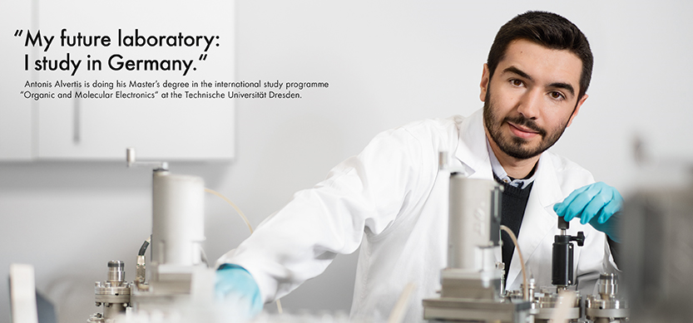
What do I need for a Scholarship Application?
© Eric Lichtenscheidt
1

Slide 2
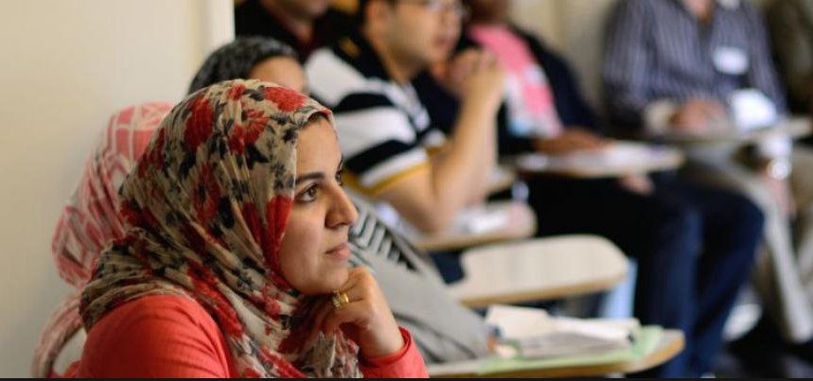
You must be an excellent student - the way you can show proof of that, is by preparing an excellent application!

Slide 3
Make an effort
Invest time
Prepare everything you need well in time
See the application as a chance to present yourself
© David Ausser / Peter Himsel

Slide 4
Today we will ….
Discuss the process of preparing a strong application
Define the different parts of a scholarship application
Be aware of common mistakes and learn how to avoid them

Slide 5
The Research
Requirements
Eligibility
Documents
Deadlines and general timeline
The organization´s mission: why do they give scholarships?
What are the conditions?

Slide 6
The Documents
Application Form
CV / Resume
Motivation Letter
Referees / Letter of Acceptance
Certificates
Proposal

Slide 7
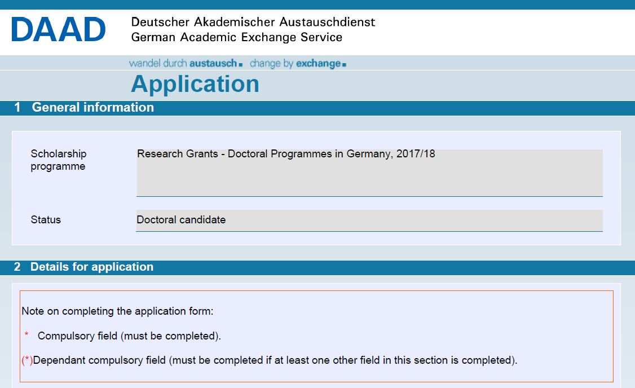
The Documents – Application Form

Slide 8
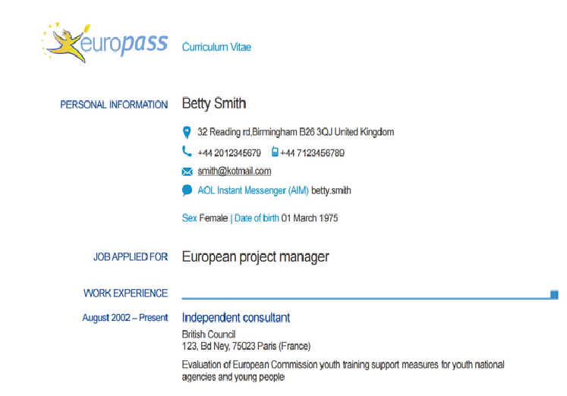
The Documents – CV
Precise
Structured
Professional
Correct terms
Form
Spelling

Slide 9
The Documents – Motivation Letter
Address it to someone
Margin, Font, Paragraphs
Name on each page, page numbers
Date, location and signature
Language!

Slide 10
The Documents – Motivation Letter
Who am I?
Why am I applying for this specific scholarship?
What are my future plans?
Why am I the right person for this specific scholarship?

Slide 11
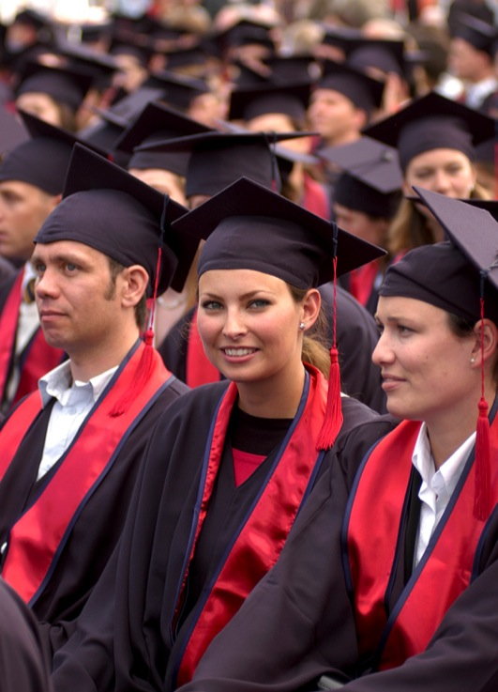
The Documents – Motivation Letter
DAAD
Scholarships for the best
Strengthen universities

Slide 12
The Documents – Letter of Reference / Acceptance
Do not wait until the last moment
Choose wisely
Talk to your Referee / Supervisor about your plans and your application
Make sure it has your name, date and signature

Slide 13
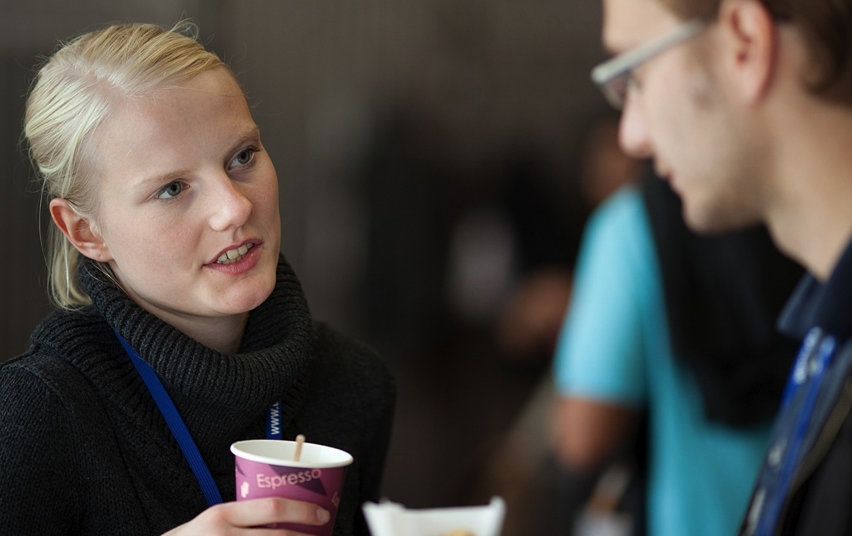
The Documents – Certificates
Letters from the university
Language certificates
…..

Slide 14
The Documents – Proposal
Goal: Convince the scientific community that you have:
identified a scientific problem
a clear theoretical/methodological approach to solve the problem
a realistic time frame and at reasonable expenses

Slide 15
The Documents – Proposal
Length: between 4-15 pages (minimum 1.500 words / for DAAD: up to 10 pages only!)
Proper layout: typeface, line spacing, table of contents, page numbers
Check grammar and spelling
Check that title, short description and content do correspond with each other
Let someone within the academic community proofread your proposal in order to make sure it conforms to international academic standards
© David Ausserhofer / Peter Himsel

Slide 16
The Documents – Proposal
The proposal needs to show that you have mastered the problems you are dealing with and that you have grasped their theoretical respectively methodological implications.
Short and precise overview of the current state of research related to your project
Name the most important contributions of other scientists
Clear discussion of the theoretical scope or the framework of ideas to be used
Research review should result in pointing out an open problem which will be the basis for your project
© David Ausserhofer / Peter Himsel

Slide 17
The Documents – Proposal
Detailed information required on:
→ How do you intend to answer your research questions?
→ What scientific literature will you consult?
→ What kind of experimental work is planned?
→ What analytical techniques will you employ?
→ How much time will you need (timetable)?
© David Ausserhofer / Peter Himsel

Slide 18
The Documents – Proposal
The research proposal has to be written by you. Any passages / sentences from another source or author have to be appropriately quoted.
Plagiarism will disqualify you!!!
© David Ausserhofer / Peter Himsel

Slide 19
Avoid Mistakes - Communication
Scholarship???
© David Ausserhofer / Peter Himsel

Slide 20
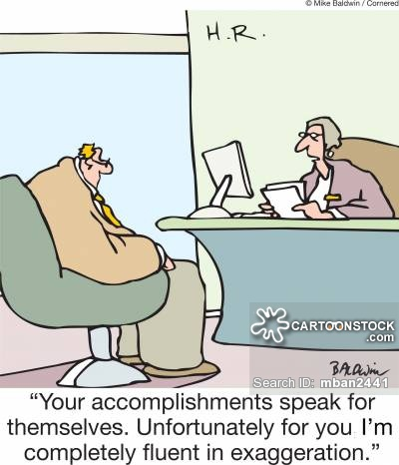
Avoid Mistakes - Overexaggerating
© David Ausserhofer / Peter Himsel

Slide 21
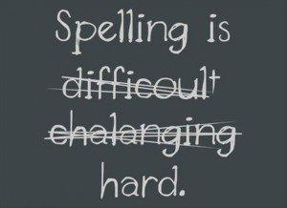
Avoid Mistakes - Presentation
© David Ausserhofer / Peter Himsel

Slide 22
Avoid Mistakes - Time
© David Ausserhofer / Peter Himsel

Slide 23
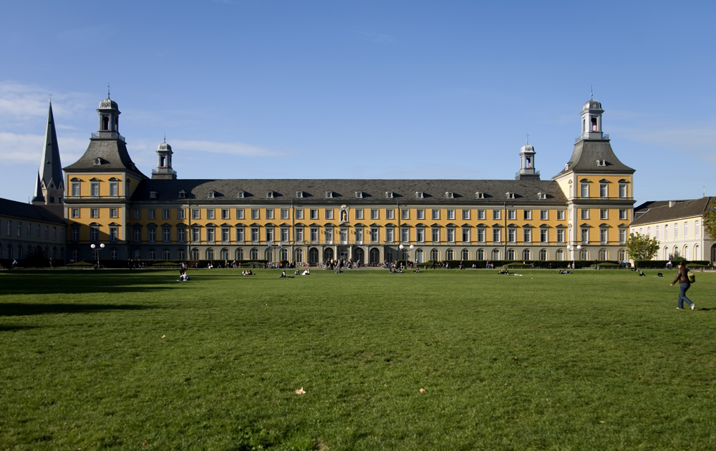
Thank you for your attention
Christina Stahlbock
Head of DAAD Information Centre (IC) East Jerusalem
02-62 62 106 info@daad-eastjerusalem.org
www.daad-eastjerusalem.org Follow us on FB
© Eric Lichtenscheidt
23

