Slide 1

DAAD
Master Programmes
© Eric Lichtenscheidt
1

Slide 2
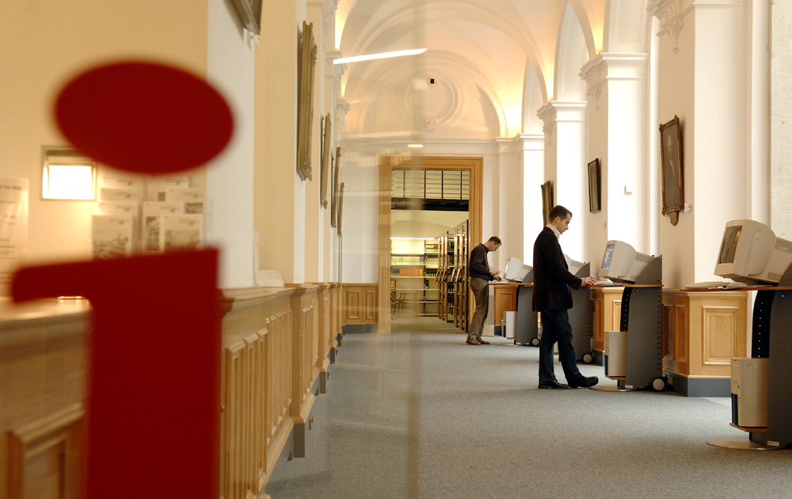
Good reasons to do a Master in Germany
© David Ausserhofer / Peter Himsel

Slide 3
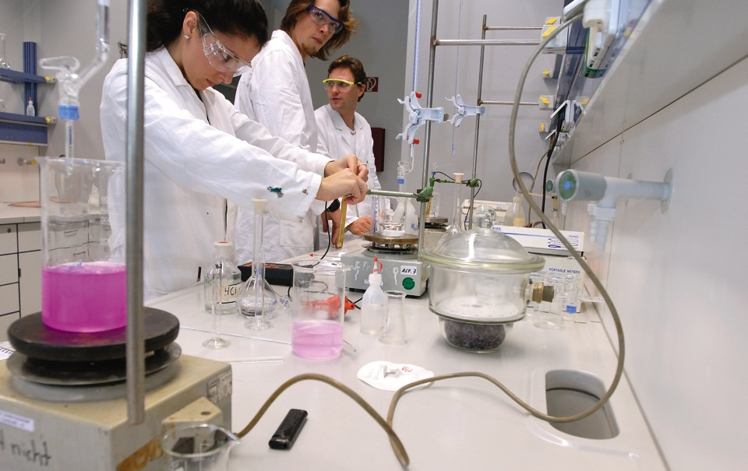
Higher Education in Germany
has an excellent reputation worldwide
© Jan Jacob Hofmann

Slide 4
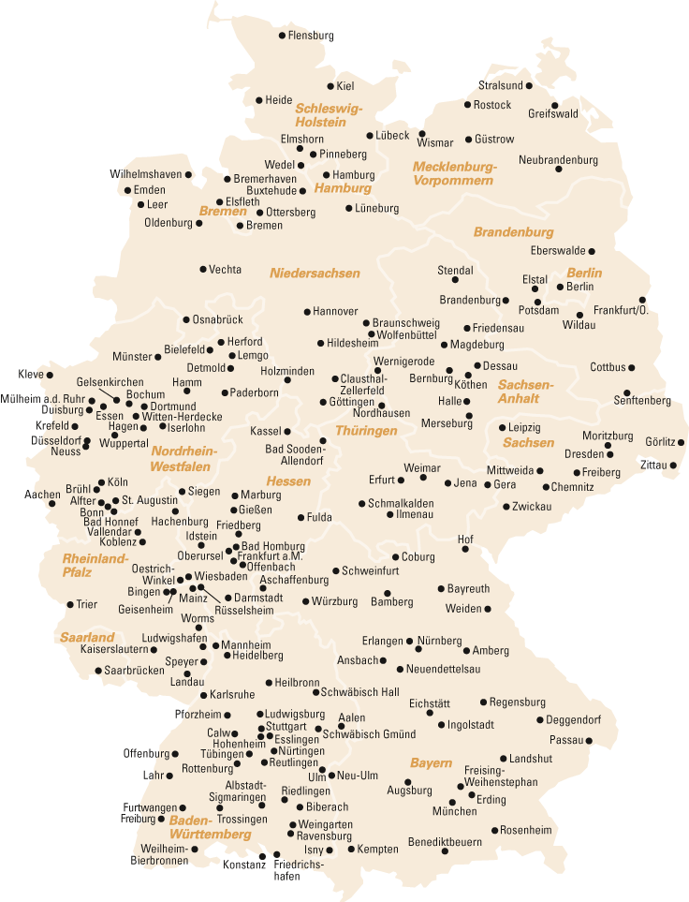
A self-governing organisation
of German universities:
  239 member universities
  122 student bodies

Slide 5

Higher Education in Germany
is innovation driven and closely interlinked with labor market needs
© Jan Jacob Hofmann

Slide 6
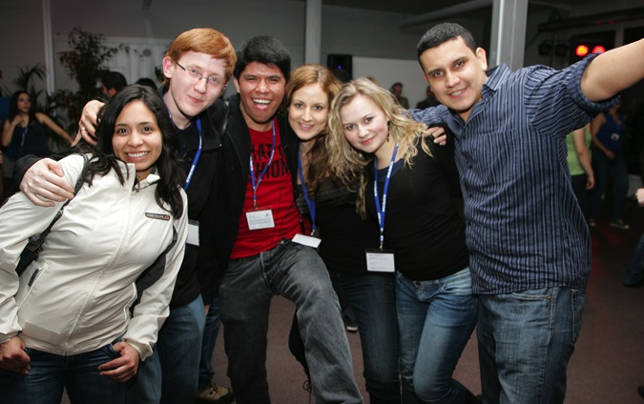
Higher Education in Germany
is internationally oriented
© Hans-Joachim Zylla

Slide 7
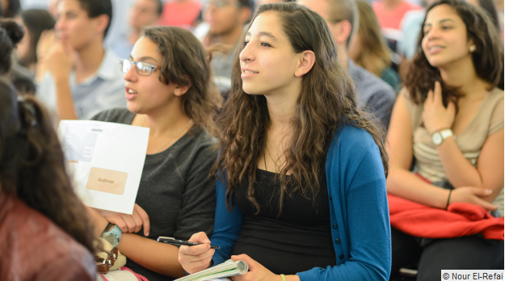
About 800 students from Palestine are currently studying in Germany
What are the advantages of studying at a German university?
What is offered in the region?

Slide 8

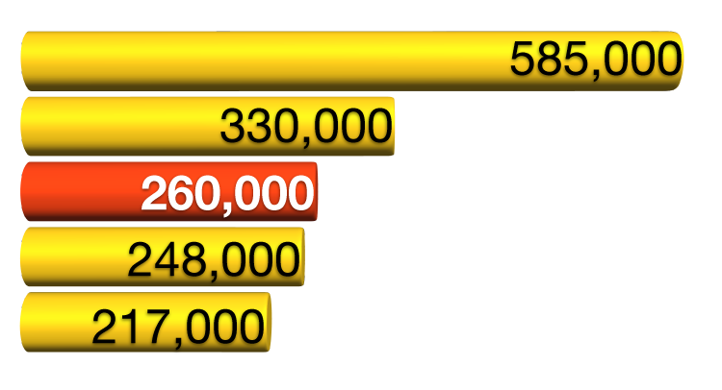
Facts about Germany
Foreign students in Germany
About 2 million students, over 12 % foreigners.
Third highest number of foreign students in the world, according to the OECD:
United States
Great Britain
Germany
France
Australia

Slide 9
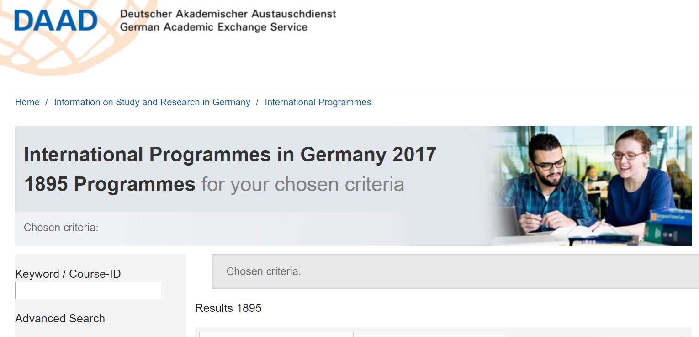

Slide 10
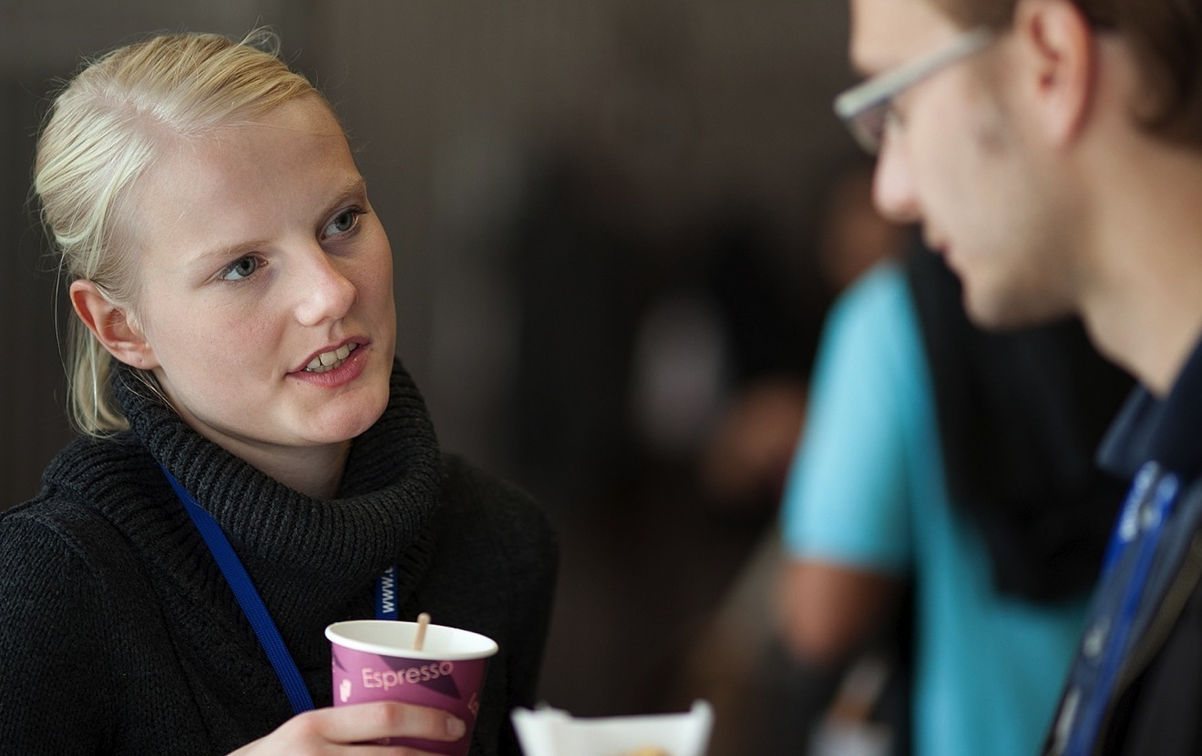
Higher Education in Germany
is mostly free, even for international students
Living costs in Germany are comparably low
© Michael Jordan

Slide 11


Studying in Germany
Tuition fees
Admission fees up to € 300 per semester (administrative costs, student union, Mensa, sports, cultural events public transport)
Tuition fees at private universities vary – check individual websites

Slide 12

Studying in Germany
Living expenses
Rent
Food
Semester ticket / public
transportation
Health insurance, medicine
Clothing
Learning materials
phone, internet, TV
culture, sports
About 857 Euro / month
€ 280
€ 160
€ 150
€ 70
€ 60
€ 40
€ 35
€ 62
€ 857

Slide 13

A degree from a German university
Allows you to stay and gather first professional experience
Offers a variety of job opportunities in your home country

Slide 14

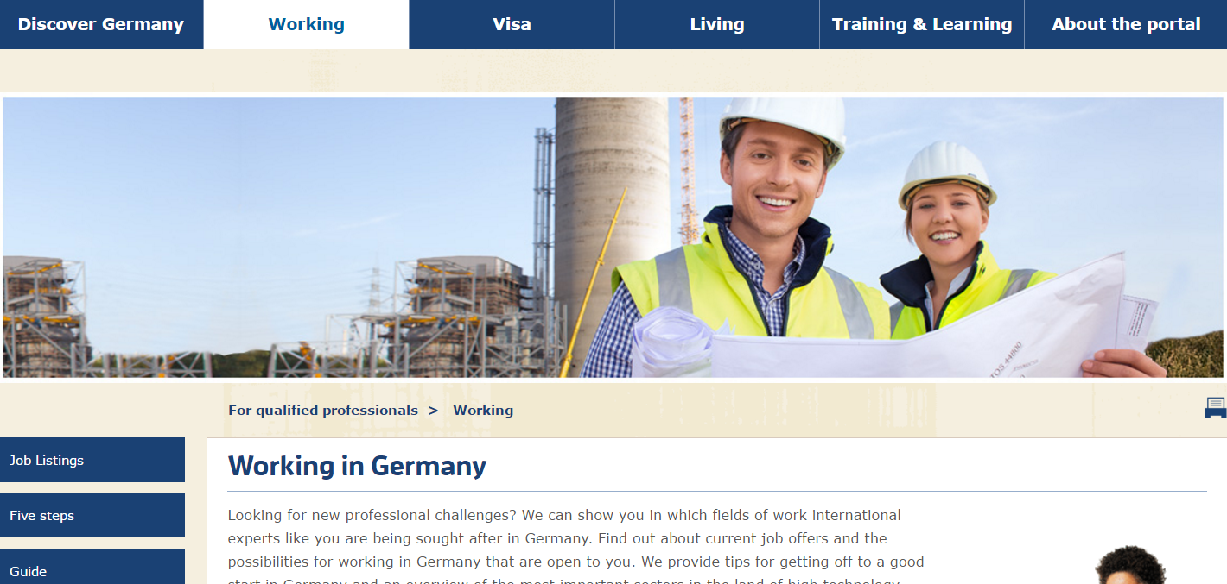
Graduates are entitled to take up a job in a field related to their studies
Residence permit for up to 18 months for the purpose of seeking suitable employment
A special jobseeker’s visa for up to six months

Slide 15
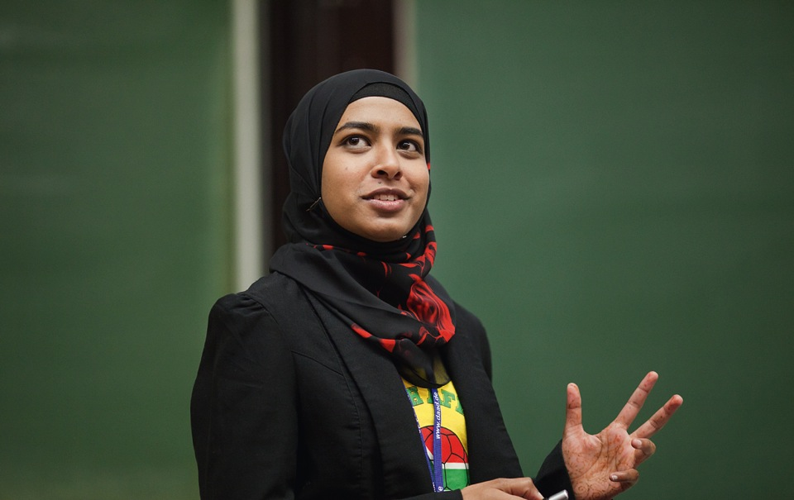
DAAD Scholarship Programmes
IDP Master
Master Jordan
EPOS
Helmut Schmidt
IASTE
© Michael Jordan

Slide 16
Study Scholarships for Graduates of all Disciplines
Who can apply?
Excellently-qualified graduates who have completed a first degree (Bachelor, Diplom or comparable academic degree) at the latest by the time they commence their scholarship-supported study programme.
What can be funded?
Participation in a postgraduate programme after a first undergraduate course
the first or second year of study at a state or state-recognised German university as part of a postgraduate or Master's degree programme completed in the home country or in another foreign country

Slide 17
Study Scholarships for Graduates of all Disciplines
Requirements:
not for applicants who have been resident in Germany for longer than 15 months
Applicants are responsible for application & admission to host university on time
Must gain admission to Master program before scholarship begins for DAAD Scholarship Award Letter to be valid
Study period / work placement abroad ( except home country) only if essential and not exceeding a quarter of scholarship period
DAAD language requirements: TOEFL 550/79, IELTS 6.5, not older than 2 years, universities’ requirements may differ

Slide 18
Third Country Scholarships for Postgraduate Studies for Students from Palestine and Yemen
Who can apply?
Highly-qualified university graduates aiming at a university career in their home country.
What can be funded?
Master's degree programmes at a state or state-recognised private university in Jordan

Slide 19
Third Country Scholarships for Postgraduate Studies for Students from Palestine
Requirements:
academic career plans in home country
final examination / degree no longer than six years before deadline
applicants must pass university entrance exams and get admission to a Master course in the Thesis Track for the DAAD scholarship to come into effect
DAAD language requirements: TOEFL 550/79, IELTS 6.5, not older than 2 years, universities’ requirements may differ

Slide 20
For both programmes
Application documents:
Full tabular CV / resume (max. 3 pages)
letter of motivation, statement of academic and personal reasons for planned study project (1 - 3 pages)
University degree certificate with final grade – to submitted at the latest before scholarship begins
Institutional recommendation by a Palestinian university
Certified English translation of Bachelor certificate with full overview of grades
Certified English translation of university entrance qualification (tawjihi)
One recent reference /recommendation from a university teacher in a sealed envelope
TOEFL or IELTS certificate (not older than 2 years)

Slide 21
Timeline for both programmes
Deadline: 31st August 2017
Pre- selection interviews: October & November 2017
Final selection in Germany: January 2018
Announcement of results: March 2018
For IDP: Start German course: June 2018
Start Master studies: Autumn 2018

Slide 22
Development-Related Postgraduate Courses (EPOS)
Who can apply?
Graduates with at least two years' professional experience
What is supported?
Individual scholarships exclusively for listed postgraduate courses in Germany
Selection
Candidates with above-average result in first academic exam, with at least two years' professional experience and with development-related motivation

Slide 23
Development-Related Postgraduate Courses (EPOS)
Requirements:
Last academic degree no longer than six years before deadline
Minimum two years' relevant professional experience
Language skills: Depend on chosen study programme
For further information on available programmes and required documents please refer to the brochure
"Development-Related Postgraduate Courses - Educating Professionals for Sustainable Development 2017/2018“
(Available on DAAD website)

Slide 24
Helmut-Schmidt-Programme (Master’s Scholarships for Public Policy and Good Governance - PPGG)
For future leaders in politics, law, economics and administration
Open to very well qualified graduates with a first university degree in the field of social sciences, political sciences, law, economics and in public administration
Scholarships are open for young graduates without professional experience as well as for mid-career professionals
The scholarships are awarded for selected Master courses
For further information on available programmes requirements and documents please refer to the websites of DAAD and the Master course you intend to apply to

Slide 25
Practical Traineeships for Foreign Students of Natural and Technical Sciences, Agriculture and Forestry - IASTE
This programme aims to improve the professional and practical qualifications and intercultural skills of programme participants
Who can apply?
Students of Natural and Technical Sciences, Agriculture and Forestry
What is supported?
Internships in commercial enterprises, research and higher education institutes.
Duration of funding
Internships of usually two to three months are arranged, in some cases longer. The length of the internship is decided by the internship provider.

Slide 26
Practical Traineeships for Foreign Students of Natural and Technical Sciences, Agriculture and Forestry - IASTE
Application deadline
Applicants should contact the IAESTE committee in their country of origin to find out the closing date for applications.
Students interested in completing an internship in Germany from the above disciplines should contact the IAESTE national committee in their home country.
The addresses of the national committees and other details are available on the IAESTE website: www.iaeste.org.

Slide 27
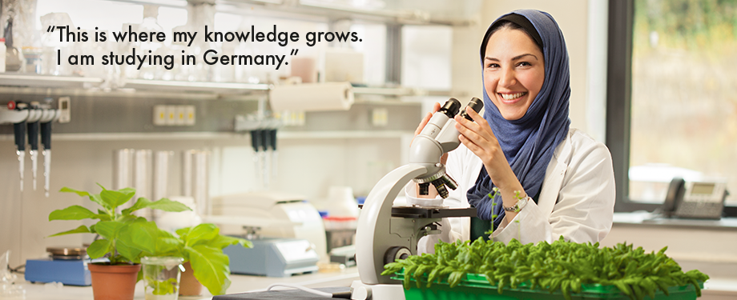
Please note:
Calls will be published in July
Check for changes to requirements or procedure!
© Christian Lord Otto
27

Slide 28
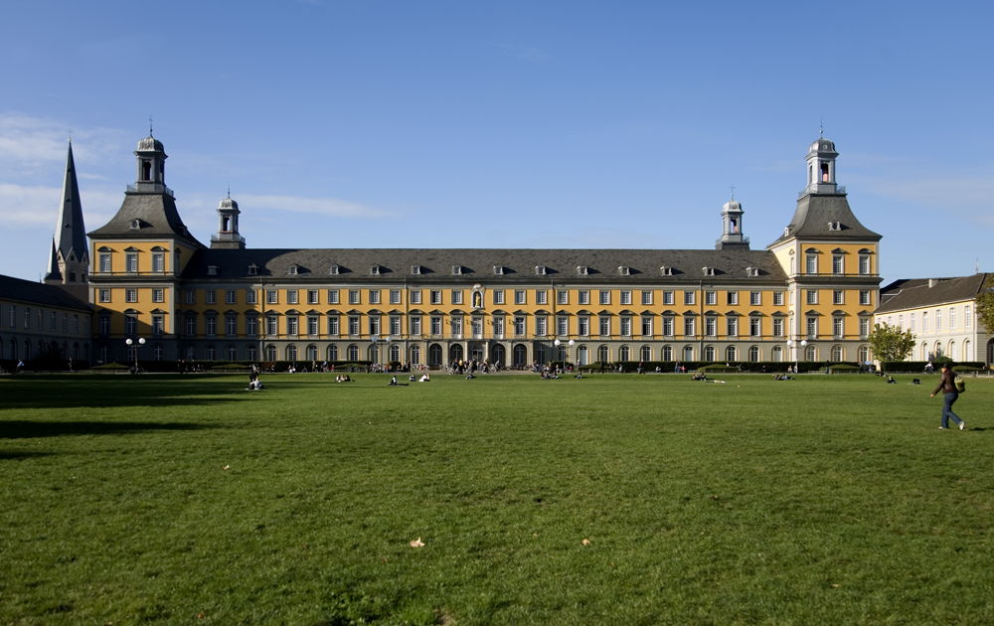
Thank you for your attention
Christina Stahlbock
Head of DAAD Information Centre (IC) East Jerusalem
02-62 62 106
info@daad-eastjerusalem.org
www.daad-eastjerusalem.org Follow us on FB
© Eric Lichtenscheidt
28

