Slide 1
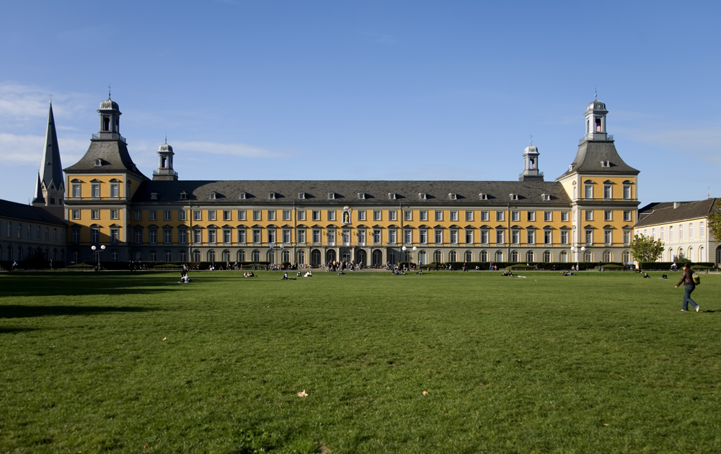
Welcome …
DAAD and Germany Alumni
© Eric Lichtenscheidt
1

Slide 2
Definition
DAAD Alumni…
did their Master or PhD with a DAAD scholarship (including Third Country scholarship holders who studied in Jordan)
are all colleagues from Palestinian universities who received a DAAD scholarship for a Study/Research Visit at least once (for a period of three months)
are all Palestinian colleagues, who studied with a scholarship in the former German Democratic Republic (DDR)
Germany Alumnus is anyone who…
studied, researched, trained and worked in Germany or finished their education there.

Slide 3
Scholarships for the Best
Supporting students, researchers and artists in both directions
1,175,000
Germans have seen the world
860,000
foreigners have come to Germany
(1950 – 2014)

Slide 4
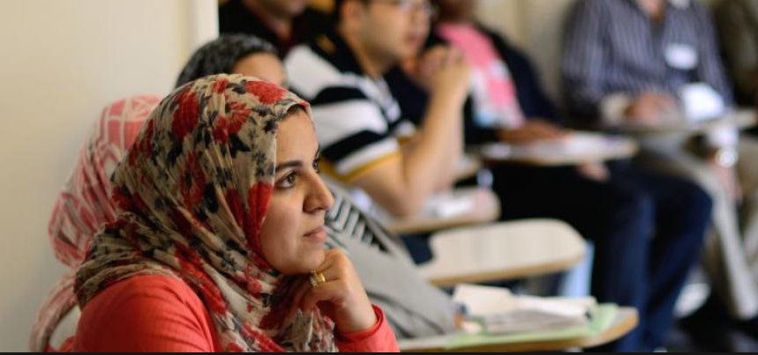
The DAAD has introduced about 800 Palestinians to Germany since 1950.
© Wolfgang Hübner-Stauf

Slide 5
Scholarships for the Best
Funding recipients in 2015
156
through individual grants
117
through project funding
273
DAAD Förderung - gesamt

Slide 7
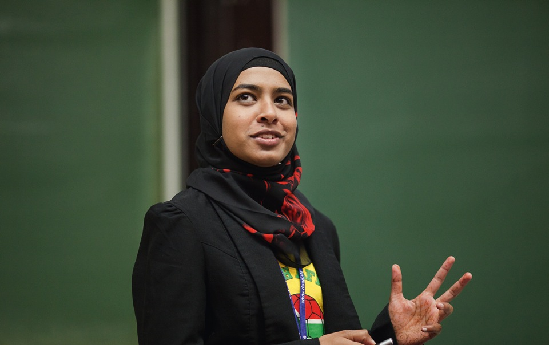
Alumni Associations in Palestine
Palästinensicher Deutscher Verein für Akademiker (PADEVA)
c/o Dr. Samah Abu Assab
Westbank
Palästinensische Deutsche Vereinigung für Akademiker,
c/o Dr. Khalil Tubail
GAZA
© Michael Jordan

Slide 8
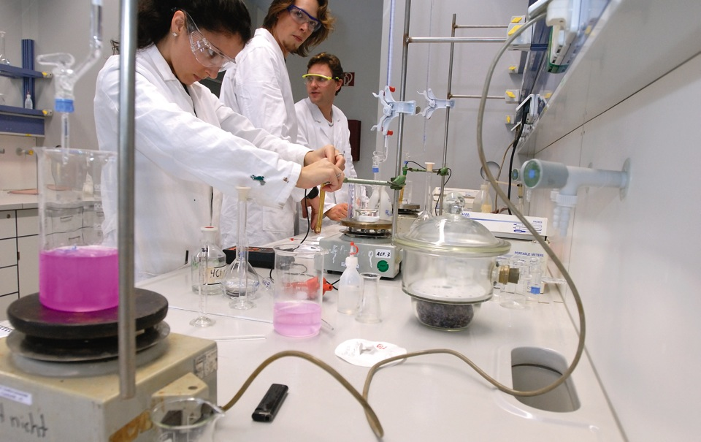
Re-Invitation Programme
Who can apply
Former holders of DAAD research grants or study scholarships (six months)
Former East German scholarship holders who studied for at least one year in Germany
What is funded
Research & working projects at state or state-recognised institutions of higher education or non-university research institutes in Germany.
Working stays at an institution in business, administration, culture or media for former scholarship holders who work outside the science sector.
© Jan Jacob Hofmann

Slide 9
Re-Invitation Programme
Funding once within three years for one to three months
Applicants must have returned to their home country at least three years previously
The research or working project must be coordinated with a cooperation partner in Germany
Deadline is the 31st August

Slide 10
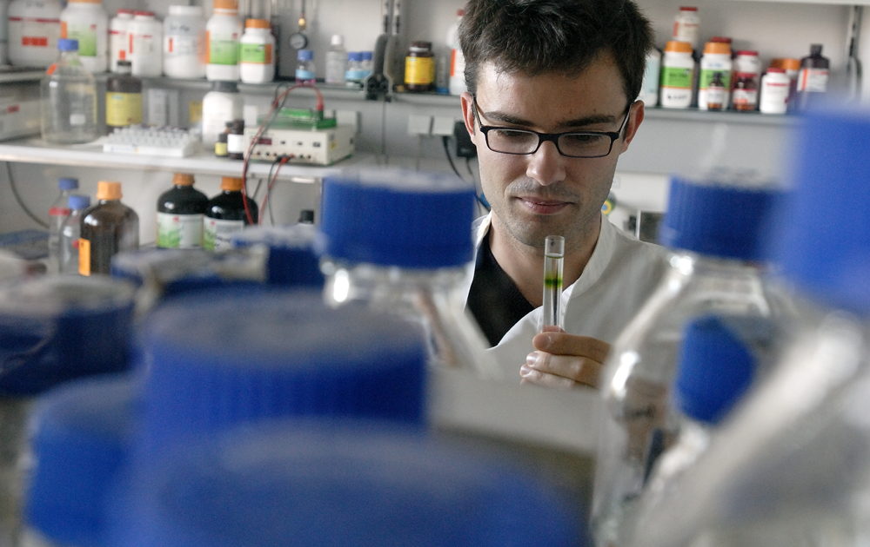
Material Resources Programme
Who can apply
Former DAAD scholarship holder (at least three months)
Germany Alumni (research)
What is funded
Equipment grant linked to a specific teaching, research, consultary or service-orientated project.
© Jan Jacob Hofmann

Slide 11
Material Ressource Programme
Applications possible at any time
Small scale projects: up to 3.500 Euros
Large scale projects: 3.500 – up to 20.000 Euros in total, a contribution normally of at least 10% of the total cost is expected by the applying institution. A statement of the German partner is required.
On delivery the equipment becomes the property of the institution
An application for the coverage of the transport cost can be submitted formlessly

Slide 12
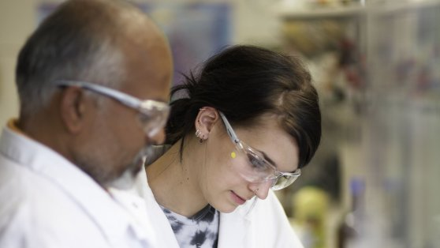
Paths to a doctorate
Alumni projects
Who can apply
Former DAAD scholarship holders or organizers of an event in which DAAD scholarship holders take part
What is funded
Scientific seminars for graduates from German higher education institutions

Slide 13
Alumni projects
The event must offer a specific topic. Grants cannot be awarded for purely social meetings
A substantial number of former DAAD scholarship holders must be participating in the event
Assistance in finding suitable German lectures and speakers may be provided
Possibility of funding travel, accomodation and meals for speakers and former scholarship holders
Grant towards the costs of event

Slide 14
Re-Invitation Programme
Weitere Informationen
Portal for Germany Alumni
Organised by DAAD, AvH, GIZ, Goethe Institut

Slide 15
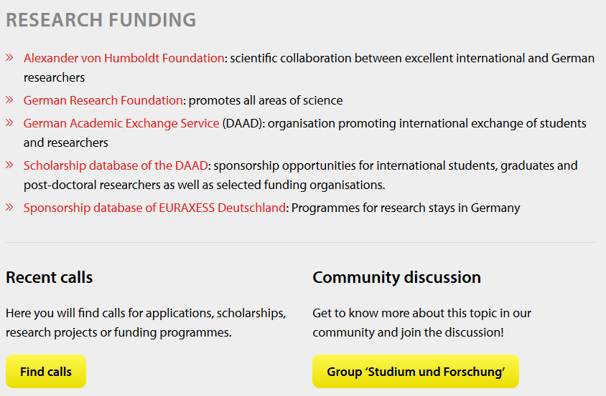
Alumniportal Germany
Connect with people worldwide
Webinars, blogs, forums
Alumni Calendar for the latest events
Calls and job postings
Alumni Special Projects
Alumni magazine LETTER

Slide 16
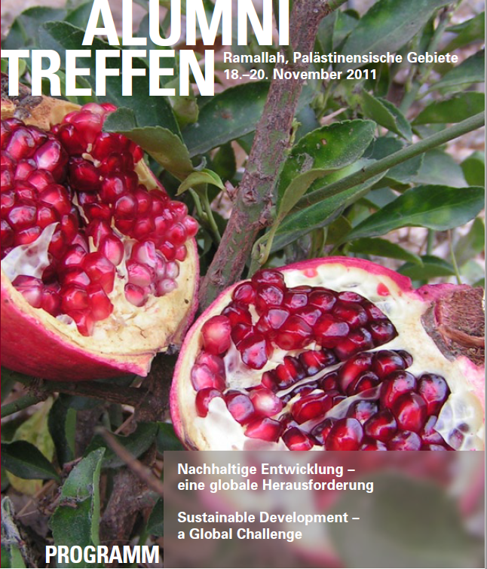
IC East Jerusalem offers
Counselling on programmes
Inclusion in scholarship selections
Alumni meetings and activities

Slide 17
Thank you for your attention
Christina Stahlbock
Head of DAAD Information Centre (IC) East Jerusalem
02-62 62 106 info@daad-eastjerusalem.org
www.daad-eastjerusalem.org Follow us on FB
© Eric Lichtenscheidt
17

